Slide 1
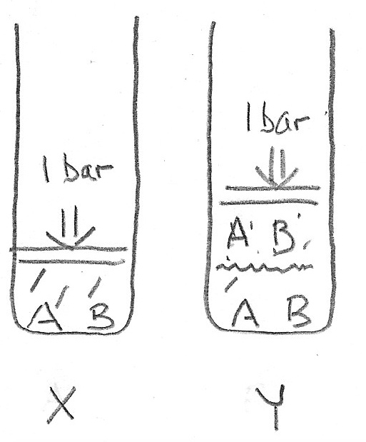

Vapor enrichment of volatile components
If A is more volatile than B, then the gas will be enriched in A, compared to the liquid
At fixed pressure, varying $T$
That means the liquid will be enriched in B, compared to the gas

Slide 2
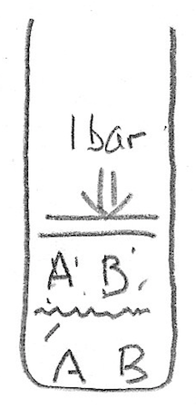
What if you could take the A-enriched gas, and turn it into a liquid?
Condense
Now we have liquid that’s more rich in A than we started with. Called simple, or 1-plate distillation

Slide 3
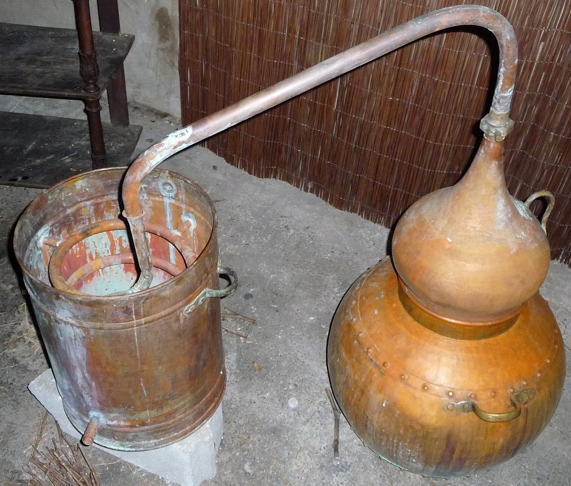
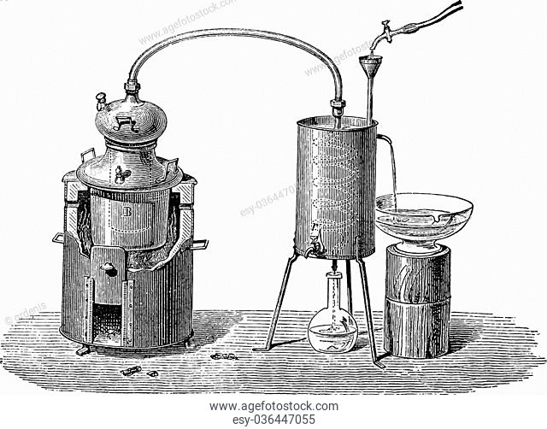
1-plate distillation apparatuses

Slide 4
“2-plate distillation”
This liquid is even richer in A
1st condensation
2nd condensation

Slide 5
“3-plate distillation”
1st condensation
2nd condensation
3rd condensation

Slide 6
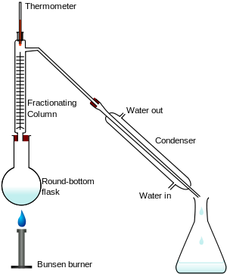
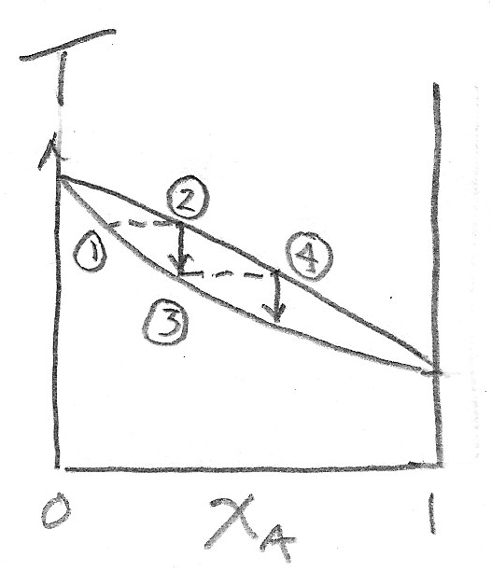
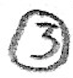


Fractional distillation (multiple plates)
cold
vapor composition
hot
liquid composition

Slide 7
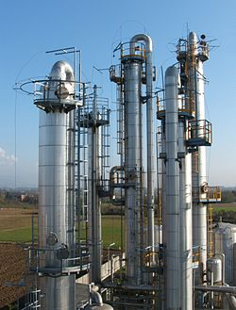
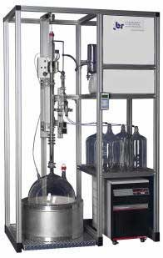
Commercial-scale fractional distillation

Slide 8
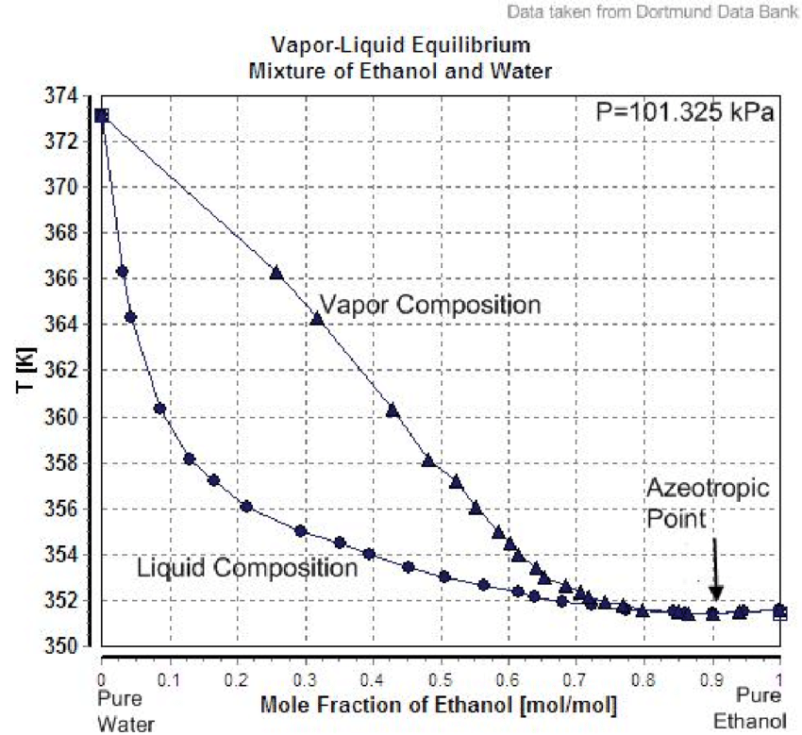
Blackboard work … predict the composition of a distillation
https://www.researchgate.net/profile/Vera-Montalbano/publication/259470569/figure/fig2/AS:614303761723443@1523472838539/Boiling-point-in-function-of-liquid-composition-of-a-mixture-of-ethanol-and-water-at-a.png

Slide 9
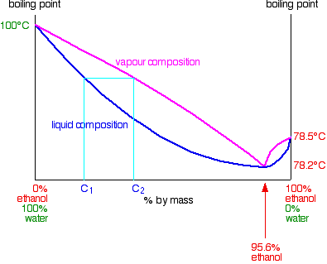
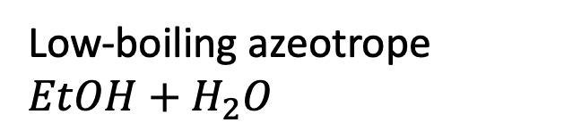
The 95.6% EtOH/4.4% H₂O azeotrope
Low-boiling azeotrope $EtOH+H_{2}O$
B is water
A is ethanol

